Slide 1
INTENT DETECTION USING Natural Language Understanding
Batch-246
Guided by:
DR.C.KARTHIKEYAN
Members:
p.Franklin Joseph(180030767)
g.Keerthi(180031083)

Slide 2
Abstract
Natural language understanding (NLU) converts sentences into structured semantic forms.
The paucity of annotated training samples is still a fundamental challenge of NLU.
To solve this data sparsity problem, semi-supervised learning mainly focuses on exploiting unlabeled sentences.
So here we use a dual task of NLU, semantic-to-sentence generation (SSG), and propose a new framework for semi-supervised NLU with the corresponding dual model.

Slide 3
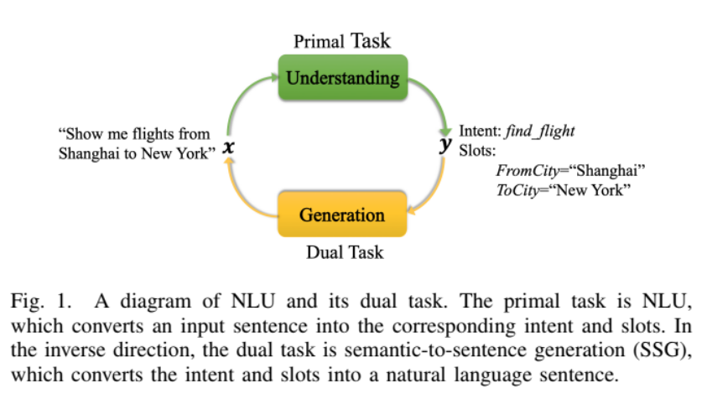
abstract
By incorporating the dual task, the framework can exploit pure semantic forms as well as unlabeled sentences, and further improve the NLU and SSG models iteratively in the closed-loop.

Slide 4
EXISTING SYSTEM
Motivated by a number of successful neural network and deep learning methods in natural language processing, many neural network architectures have been applied in the intent detection and slot filling, such as RNN, CNN, LSTM, encoder-decoder, transformers etc.
Most of the previous work tends to share the encoders of the intent detection and slot filling while leaves their decoders (e.g., classification layers) independent. Besides, some investigations focus on interrelated modeling of intent detection and slot filling, which is orthogonal to the semi supervised learning of NLU.
The traditional approaches of semi-supervised NLU utilize unlabeled sentences to improve NLU performances in two ways.
1) NLU model trained with the existing labeled sentences is exploited to predict pseudo-labels for unlabeled sentences, which can be used to retrain the NLU model.
2) Except for the pseudo-labeling method, some prior works design several unsupervised tasks to make use of the unlabeled sentences, like language models sequence-to-sequence based sentence reconstruction

Slide 5
Proposed system
The framework is composed of dual pseudo-labeling and dual learning method, which enables an NLU model to make full use of data (labeled and unlabeled) through a closed-loop of the primal and dual tasks.
By incorporating the dual task, the framework can exploit pure semantic forms as well as unlabeled sentences, and further improve the NLU and SSG models iteratively in the closed-loop.
The proposed approaches are evaluated on two public datasets (ATIS)
Now this proposed method can also achieve the state-of-the-art performance on the two datasets in the supervised setting.

Slide 6

NLU Task Formulation
Intent detection and slot filling are major tasks of NLU in task-oriented dialogue systems. An intent is a purpose or a goal that underlies a user-generated utterance and slot filling aims to automatically extract a set of attributes or “slots”, with the corresponding values.
An example of data annotation :
The user’s intent is to find flights. For slot annotation, it follows the popular inside/outside/beginning (IOB) schema, where Boston and New York are the departure and arrival cities specified as the slot values in the user’s utterance, respectively.

Slide 7
NLU Model Architecture
The basic multitask framework of intent detection and slot filling is comprised of three modules: sentence encoding, intent classification, and slot tagging.
Sentence Encoding:
Every input word is mapped to a vector. An BLSTM encoder is applied to get hidden vectors
Intent Classification:
An attention model is applied to gather a sentence embedding, and then feed it into a linear output layer for intent classification
Slot Tagging:
Slot filling is considered as a sequence labeling problem which tags each input word sequentially. There are three typical methods for slot tagging concerning the time series dependence of slot tags,
BLSTM-softmax, BLSTM-CRF, BLSTM-focus.

Slide 8
Methods of slot tagging
Softmax function, a wonderful activation function that turns numbers aka logits into probabilities that sum to one. Softmax function outputs a vector that represents the probability distributions of a list of potential outcomes.
Conditional Random Fields (CRFs) models have been verified to be effective and widely used in IE(Information Extraction).
In the sequence labelling task, the input and output sequences are aligned word by word, while the attention mechanism cannot provide the exact alignment. To address this limitation, a novel focus mechanism for encoder-decoder framework.

Slide 9
DATA SET
ATIS (Airline Travel Information Systems):
The ATIS (Airline Travel Information Systems) is a dataset consisting of audio recordings and corresponding manual transcripts about humans asking for flight information on automated airline travel inquiry systems.
The data consists of 17 unique intent categories.
Tasks like intent detection, semantic parsing, sql parsing, slot filling can be best explained using ATIS dataset.
Recent studies reported error rates below 5% for these tasks employing discriminative machine learning techniques with the ATIS test set.

Slide 10
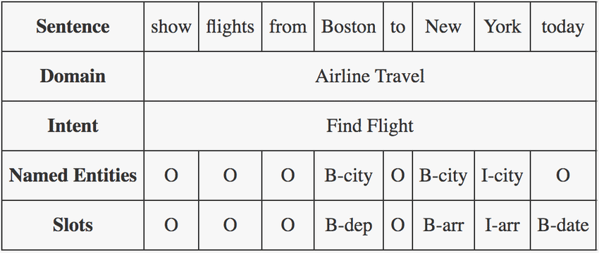
The evaluation methodology supported by ATIS depends on having a comparable representation of the answer for each utterance. This is accomplished by limiting the utterances to database queries, and the answers to a ground set of tuples from a fixed relational database.
The large majority of the questions posed by subjects can be answered from the database with a single relational query.
The ATIS database was designed to model as much of a real-world resource as possible.
Example:

Slide 11
Module description
The modules which are used in the project are:
NumPy
Pandas
NumPy can be used to perform a wide variety of mathematical operations on arrays and numbers
Pandas is built on top of two core Python libraries—matplotlib for data visualization and NumPy for mathematical operations. Pandas acts as a wrapper over these libraries, allowing you to access many of matplotlib's and NumPy's methods with less code.

Slide 12
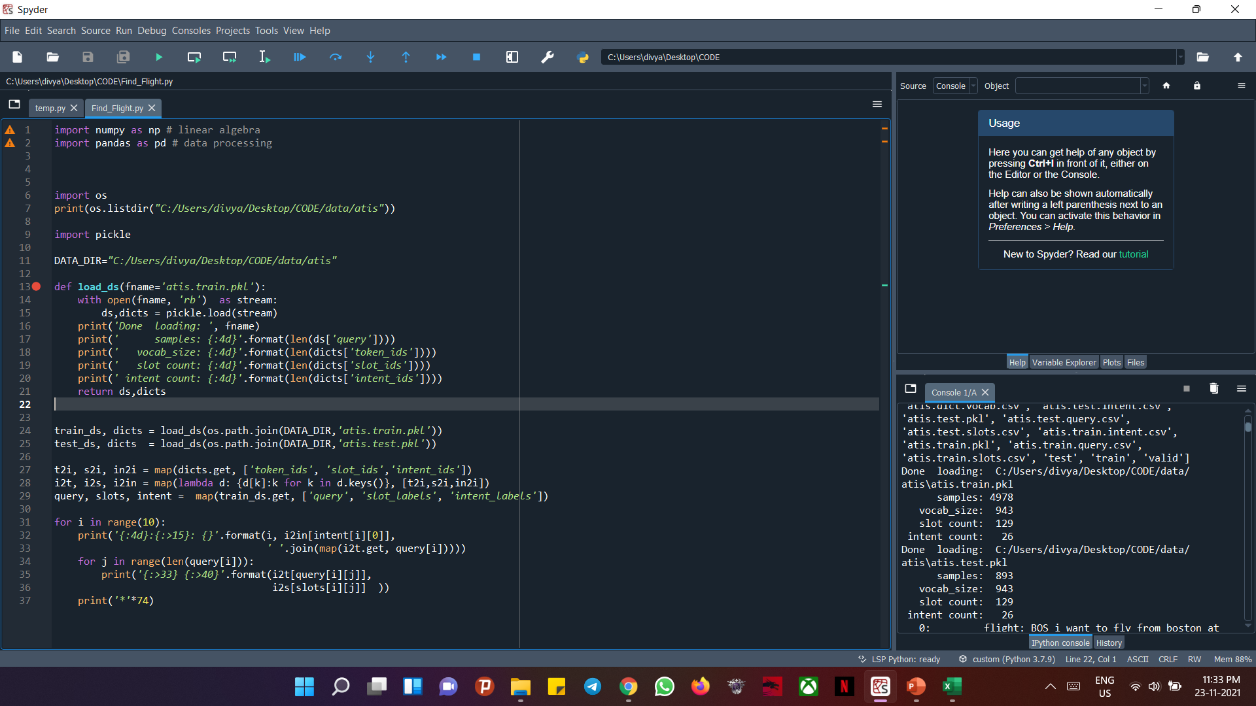
implementation

Slide 13
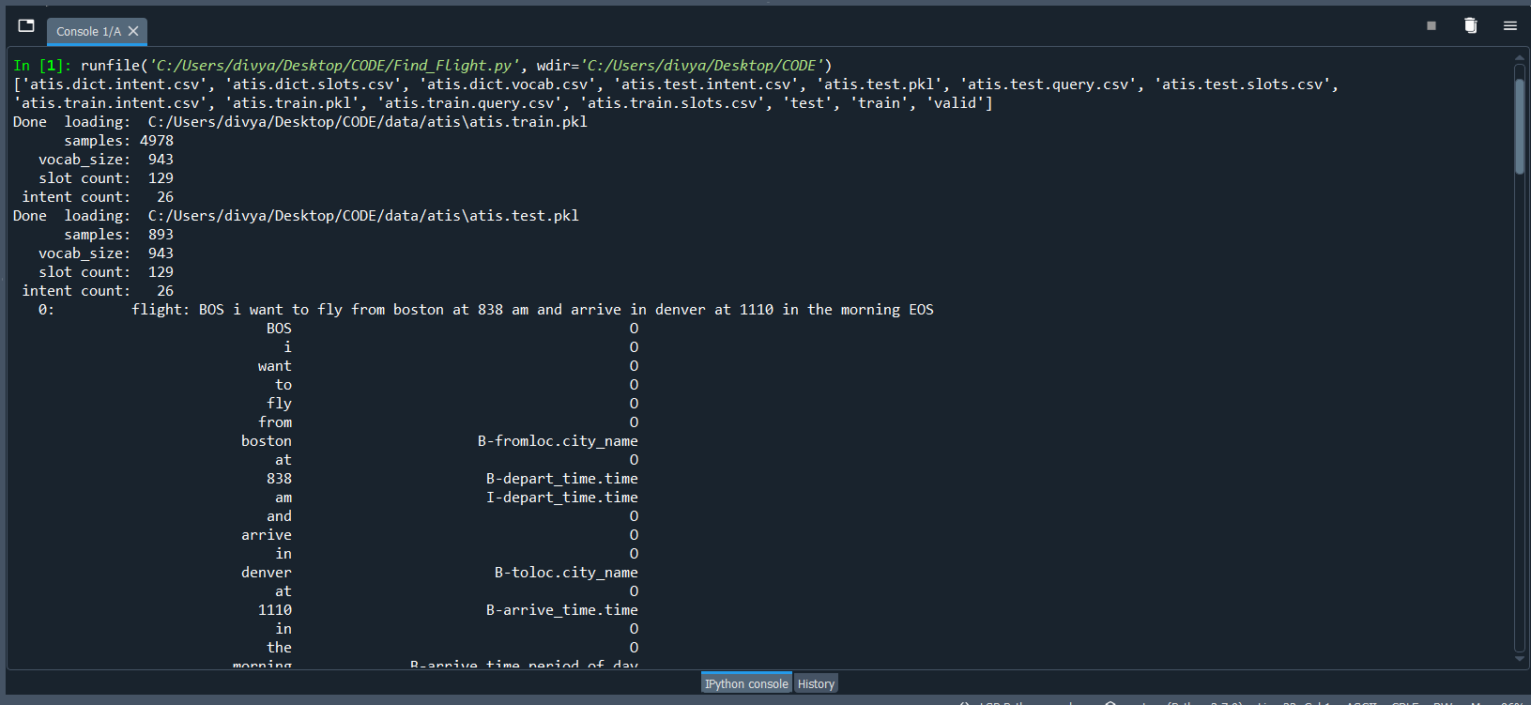
output

Slide 14
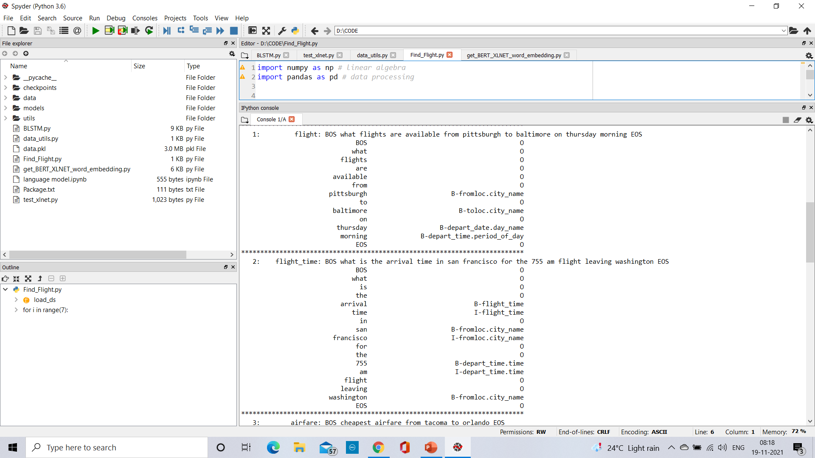
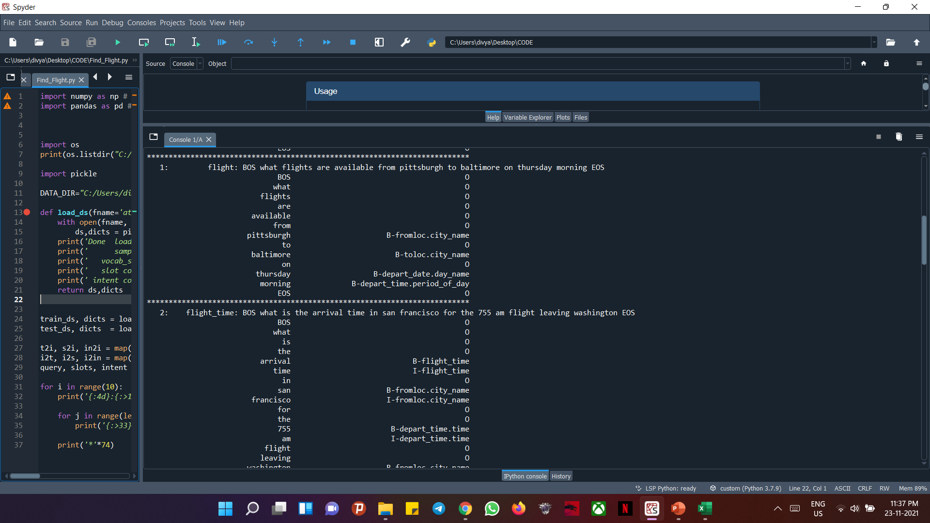

Slide 15
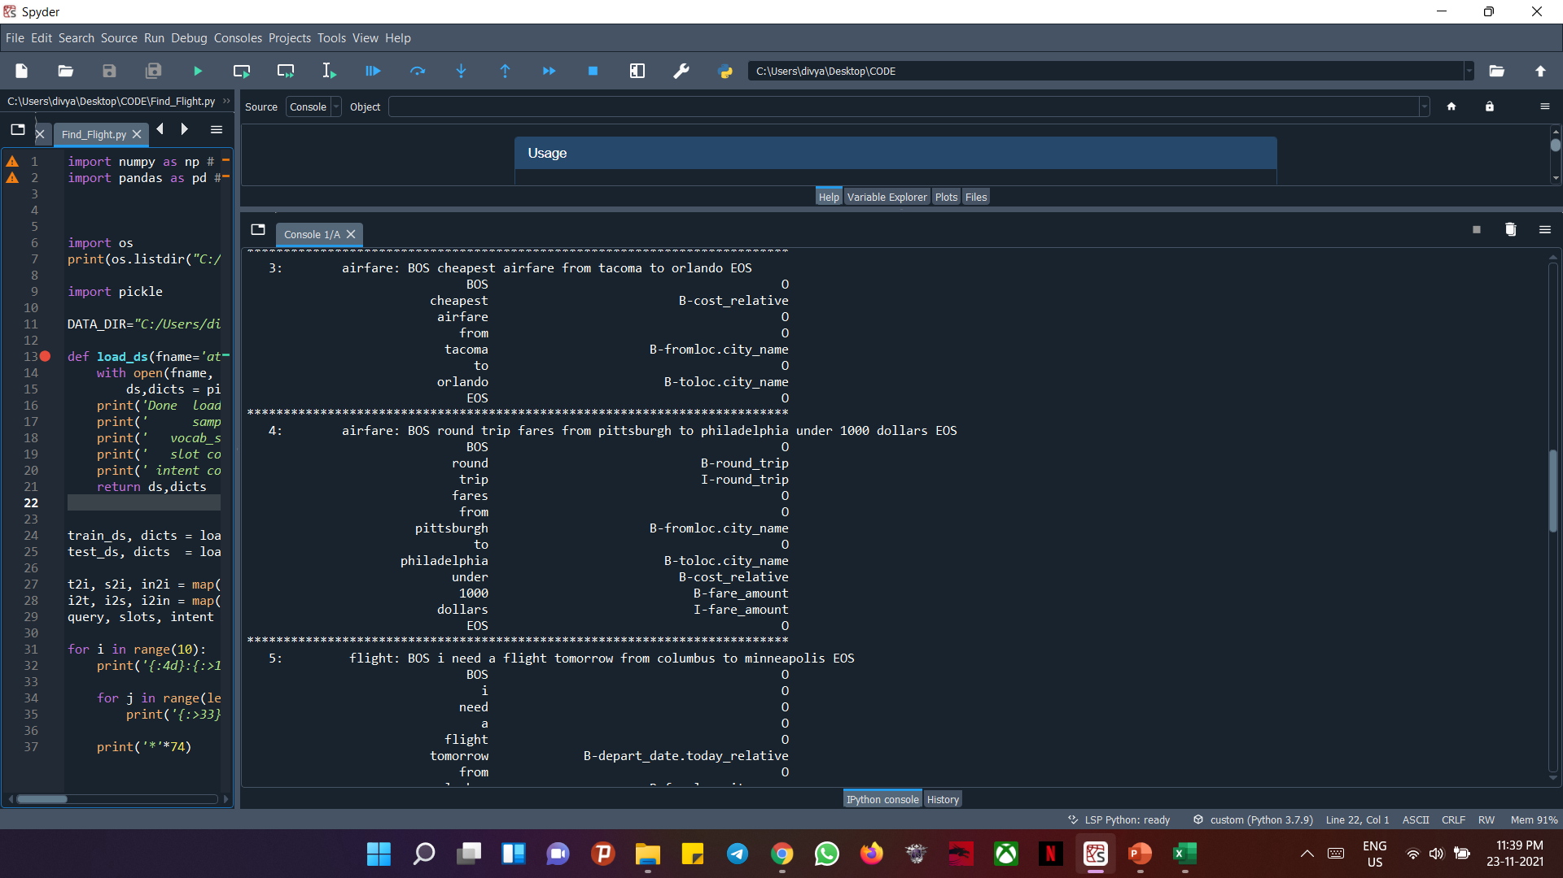

Slide 16
conclusion
A dual task for SLU is introduced, which is semantic-to-sentence generation (SSG). It is incorporated in our proposed dual semi-supervised NLU to utilize unexpressed semantic forms as well as unlabeled sentences.
The dual semi-supervised NLU includes the dual pseudo-labeling and dual learning methods which can learn the NLU and SSG models iteratively in the closed-loop of the primal and dual tasks.
The proposed approaches are evaluated on two public datasets (ATIS and SNIPS).
From the experimental results, we find that the dual semi-supervised NLU involving SSG could significantly improve the performances over traditional semi-supervised methods.
Our method can also achieve the state-of-the-art performance on the two datasets in the supervised setting.

Slide 17


